Slide 1
Introduction to Simulation and Modeling
Azaz Ahmed Kiani

Slide 2
Analysis
(Lecture 29,30,31,32,33)

Slide 3
Introduction
After the simulation practitioner has determined the experimental design alternatives, attention can be directed toward the analysis phase of the simulation project.
The function of this phase is to provide the simulation practitioner with the information necessary to provide decision recommendations with respect to the project objectives.
Statistical analysis approach for terminating systems.
Statistical analysis approach for nonterminating systems.

Slide 4
Introduction
The analysis process for terminating systems consists of the following steps:
1. Replication analysis
2. Production simulation runs
3. Statistical analysis of the simulation run results

Slide 5
Replication Analysis for Terminating Systems
The input distributions of simulation models are usually probabilistic in nature.
This input variability naturally results in some variation in the output measures of performance.
Because the output measures have some variation, it is inappropriate for the simulation practitioner to recommend any given course of action based on the results from a single simulation run or replication.
To reduce the chance of making a wrong recommendation, it is necessary to run a number of simulation replications and then make the recommendations based on all of the available data.

Slide 6
Replication Analysis for Terminating Systems
A natural question is: If not one replication, then how many?
This is the purpose of replication analysis.

Slide 7
Initial Number of Replications
The simulation practitioner must begin with some arbitrary number of replications to begin the replication analysis.
A reasonable practitioner compromise to this situation is to initially run some small number of replications.
A common number of initial replications is ten.
This provides a sufficient number of replications to have reasonable statistical confidence given that additional replications can always be subsequently added.

Slide 8
Replication Calculations
The practitioner must first calculate the mean and standard deviation of the ten replication means.
These summary statistical values are then used to calculate what is known as the standard error of the data using the following formula:

Slide 9
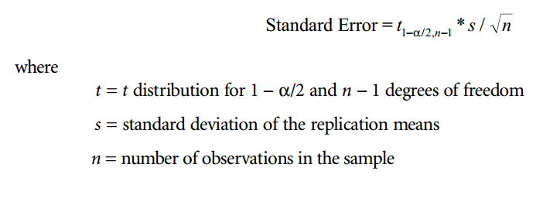
Replication Calculations

Slide 10
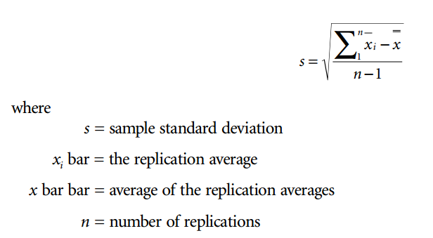
Replication Calculations (Example)
The mathematical formula for the sample standard deviation of the replication averages is:

Slide 11
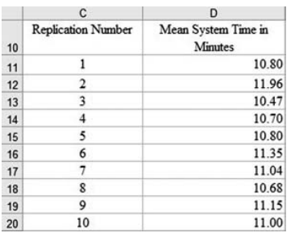
Replication Calculations (Example)

Slide 12
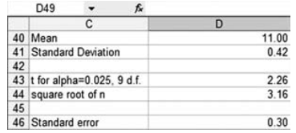
Replication Calculations (Example)

Slide 13
Replication Calculations (Example)
In our initial replication calculations we will have ten replication means.
This means that the number of degrees of freedom will be ten minus one or nine.
If we use an α value of 0.05, then the value for t with nine degrees of freedom is 2.262. We can find this value in a statistical table

Slide 14
Selecting a Level of Precision
Once we know the standard error, we can use this information to calculate how many replications we need to run.
However in order to do this, we must select a level of precision or error that is suitable for our study.
There are two general approaches
  Absolute comparison of the standard error to a particular tolerance level.
  Relative value of the standard error in comparison to the sample mean.

Slide 15
Absolute Precision
In the absolute precision approach we select a tolerable level for the precision.
The selection of an absolute precision level may appear to be somewhat arbitrary.
For example, we can arbitrarily select an absolute precision level of 0.20 min. This means that we need to run enough additional replications to reduce our standard error to 0.20.
Our current standard error with ten replications is 0.32 minutes. To determine the new number of replications that will be needed with this data set to achieve an absolute precision level of 0.20 min, we can utilize the previous standard error formula. In order to do this, we set the equation to our desired level of precision.

Slide 16
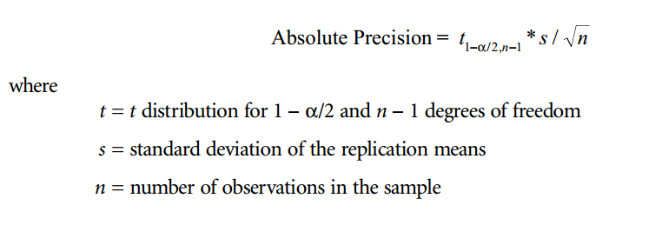
Absolute Precision

Slide 17
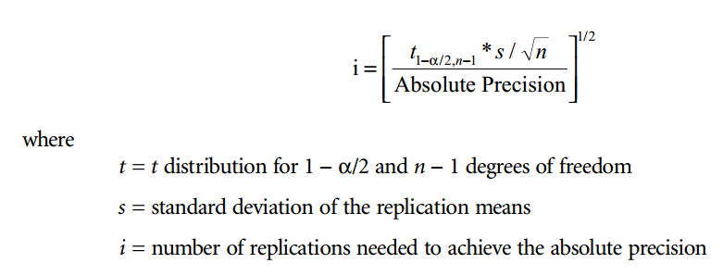
Absolute Precision
Next, we rearrange the terms and solve for the new n, the number of required replications to reach our desired level of absolute precision:

Slide 18
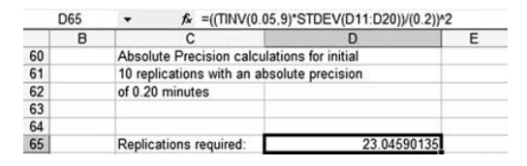
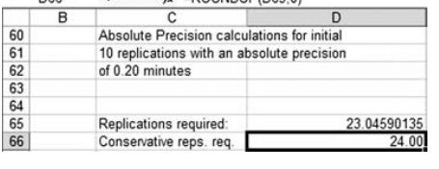
Absolute Precision
This results in a new requirement to run a total of 24 replications to achieve an absolute precision of 0.20.

Slide 19
Absolute Precision
The next step in the process is to verify that 24 replications are actually sufficient for the designated absolute precision level.
This means that the simulation model needs to be run for 24 replications, and the summary statistics recalculated.
The new summary statistics can be inserted into the absolute precision equation and checked to make sure that the new number of replications meets the absolute precision level.

Slide 20
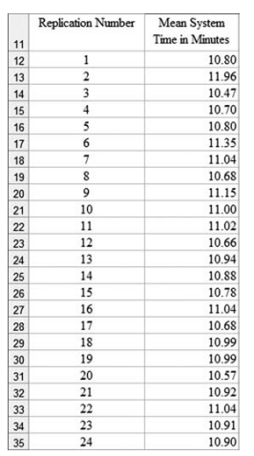
Absolute Precision (new 20 Replications)

Slide 21
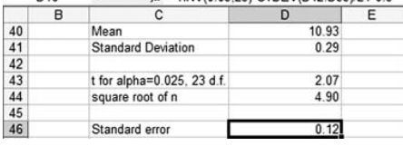
Absolute Precision (new 20 Replications Summary Statistics)
If we insert these values in our absolute precision equation, the equation is equal to 0.14.
Because 0.14 is less than our absolute precision of 0.20, 24 replications are sufficient for a robust
statistical comparison with other alternatives.

Slide 22
Relative Precision
This approach is preferred because it is not necessary to select an arbitrary absolute precision level.
The relative precision approach sidesteps this issue by creating a ratio by dividing the standard error of the data by the sample mean of the data.
For a robust statistical analysis, the standard error should be relatively small in comparison to the sample mean.
A commonly utilized practitioner value for the desired relative precision is 0.10.

Slide 23
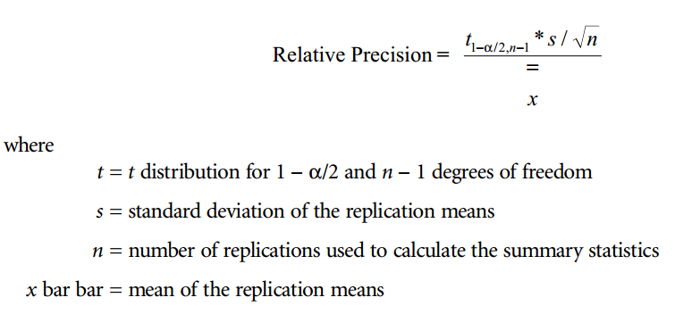
Relative Precision

Slide 24
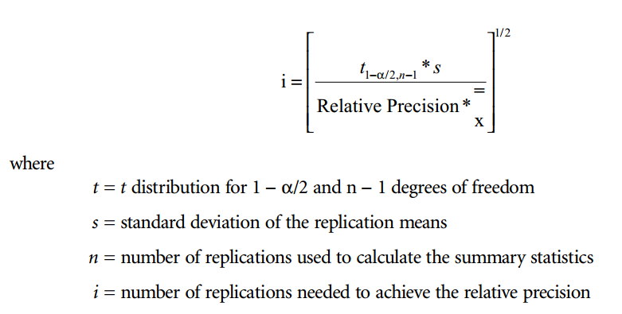
Relative Precision
In a similar fashion to rearranging the absolute precision formula, we can also rearrange the relative precision formula to find out the required number of replications to achieve a given level of relative precision:

Slide 25
Checking All of the Alternatives
Once the practitioner has an understanding of the replication analysis procedure using the base alternative, replication analysis can be performed on all of the other alternatives.
Because each of the alternative models is different with respect to either resources or operating policy, there will undoubtedly be some
difference in the means and standard deviations of the replication means.
Thus, there will naturally be some differences in either the initial absolute precision or relative precision of the models with the initial ten replications.

Slide 26
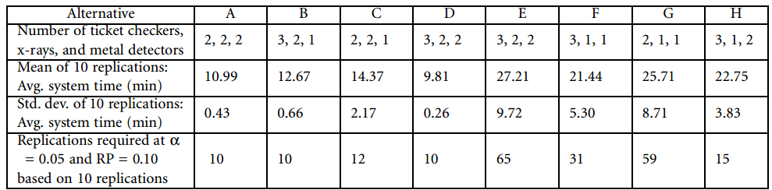
Checking All of the Alternatives

Slide 27
Checking All of the Alternatives
Note that alternative E with three ticket checkers, two x-ray machines, and two metal detectors requires a total of 65 replications to achieve a desired relative precision of 0.10.
This means that all of the individual alternatives need to be rerun individually a total of 65 times in order to subsequently perform the statistical analysis.
Therefore, the practitioner must next run a total of 520 simulation replications.

Slide 28
Statistical Analysis of Terminating System Production Runs
The statistical analysis involved in two-model comparisons is relatively simple.
In a more complicated simulation project, the practitioner could easily have many more than two models to compare.
To organize the statistical analysis process, we can categorize the analysis approaches into either:
Simple two-model comparisons
Three-model or more comparisons

Slide 29
Simple Two-Model Comparisons
For simple two-model comparisons, the practitioner can utilize either hypothesis test or confidence interval approaches.
The confidence interval approach is a modification of the corresponding hypothesis test.
It determines the interval or range over which the difference between the two models would normally expect to be observed.
Normally, practitioners utilize a 95% confidence interval. If the models are statistically similar, then the expectation is that the difference in the replication mean values will be zero.
On the other hand, if the confidence interval does not cover 0, the two models are statistically significantly differnt

Slide 30
Welch Confidence Interval Approach
The Welch confidence interval approach assumes the worst-case scenario of having dissimilar variance between the two data sets. As you might already suspect, the Welch confidence interval approach is based on the Smith–Satterthwaite t test introduced in Chapter “Validation.”
After calculating the mean and standard deviation summary statistics for each data set, the practitioner must calculate the degrees of freedom estimator as with the Smith–Satterthwaite test using the formulation below:

Slide 31
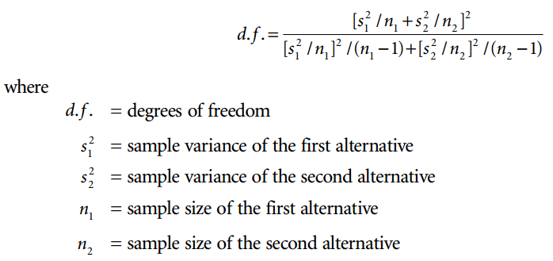
Welch Confidence Interval Approach

Slide 32
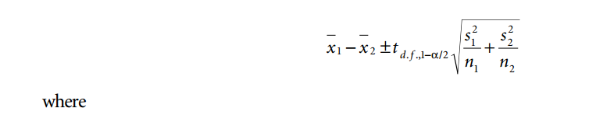
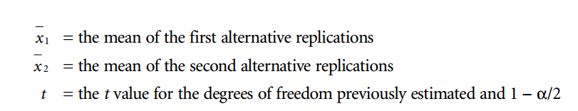
Welch Confidence Interval Approach
The Welch confidence interval can now be calculated with the following formula:

Slide 33

Welch Confidence Interval Approach
The above equation is most commonly seen in its final form with minimum and maximum values that describe the interval at a given level of confidence. The values are normally presented with square brackets separated by a comma as shown below:

Slide 34
Welch Confidence Interval Approach (Example)
The following data represent the system times in seconds for two different operating policies for our airport security checkpoint system.
Alternative A consists of two TCs, two x-ray machines/ operators, and two MDs.
Alternative B consists of three ticket checkers, two x-ray machines/operators, and one metal detector/operator.
The mean and standard deviation for alternative A are 39.58 and 1.53. The mean and standard deviation for alternative B are 45.60 and 2.38.

Slide 35
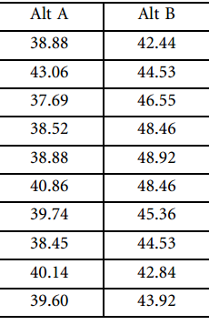
Welch Confidence Interval Approach (Example)

Slide 36
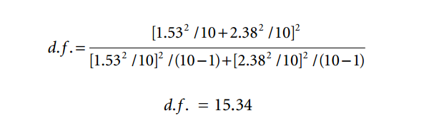
Welch Confidence Interval Approach (Example)
To calculate the Welch confidence interval at an αlevel of 0.05, we begin with the degrees of freedom estimator. The degrees of freedom estimator is calculated by:
Because we want to have as wide a confidence interval as possible, we round down to 15. This will result
in a tvalue of 2.131. The actual Welch confidence interval calculation is:

Slide 37
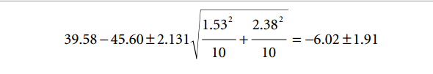

Welch Confidence Interval Approach (Example)
Because we want to have as wide a confidence interval as possible, we round down to 15. This will result in a t value of 2.131. The actual Welch confidence interval calculation is:
The confidence interval does not cover zero with an αlevel of 0.05. Therefore, we can conclude that the alternatives are statistically significantly different.

Slide 38
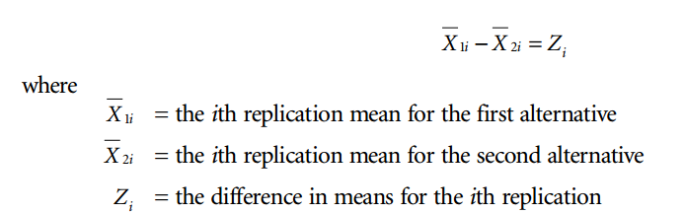
Paired t-Test Confidence Interval Approach
The paired t-test is utilized when the two models have some sort of natural pairing.
appropriate only when the entities flowing through the system have been designed for the apples-to-apples approach described in the problem formulation chapter (Chapter 2).
In this approach, we first calculate a new variable based on the difference in replication means between the two alternatives.

Slide 39
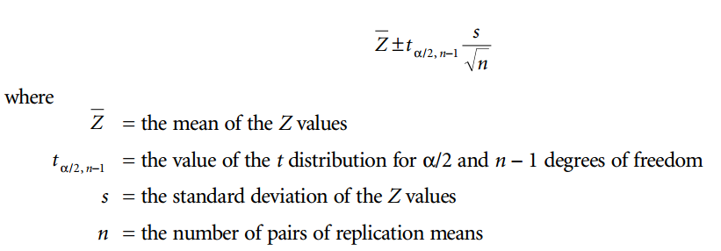
Paired t-Test Confidence Interval Approach
If you have ten replications, you end up with ten Zvalues from each pair of replication means.
Next, we calculate the average and standard deviation of the new Z variable. Last, we utilize the following formula to calculate the confidence interval:

Slide 40
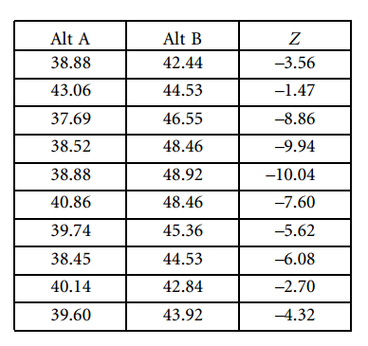
Paired t-Test Confidence Interval Approach (Example)

Slide 41
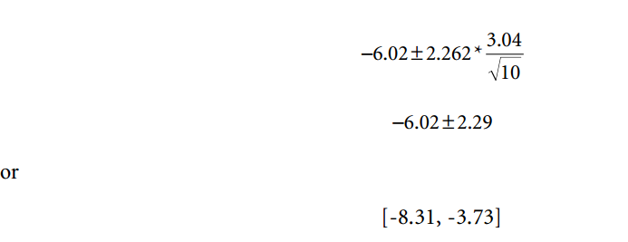
Paired t-Test Confidence Interval Approach
The mean of the Z variable is –6.02, and the standard deviation is 3.04.
The t value for 0.05/2 and nine degrees of freedom is 2.262. Inserting these values into the confidence interval equation, we obtain:
Values does not cover 0, there is statistical evidence to say that the two alternatives are statistically significantly different at an α level of 0.05.

Slide 42
Three- or More Model Comparisons
Three or more comparisons involve a two-step procedure.
Analysis of variance (ANOVA) is used to determine if there is a statistically significant difference among one or more of the means of the different models.
In order to determine which means are statistically significantly different from the other means, we must also run a Duncan multiple-range test.

Slide 43
ANOVA
Analysis of variance can be used to determine if the mean performance of one or more alternatives is statistically significantly different from the others at a given αlevel.
One or more of the means could actually be statistically significantly better or worse than the rest of the alternatives.
To begin the ANOVA process, the practitioner must have each of the individual replication means for each different alternative.
The practitioner must also have the mean value of the replications for each alternative and the single grand mean of all replications.

Slide 44
ANOVA
With these summary statistics in hand, the following calculations are required:
Calculate the sum of squares total.
• Calculate the sum of squares between.
• Calculate the sum of squares within.
• Calculate the mean squares between.
• Calculate the mean squares within.
• Calculate the f statistic.
•Compare the f statistic to a critical f value.

Slide 45
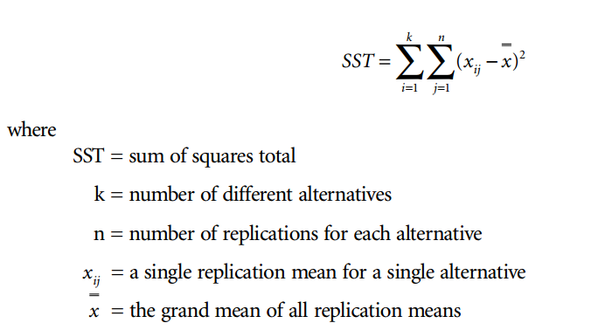
Calculating the Sum of Squares Total
The sum of squares total is a summation of the difference between each individual replication mean and the grand mean squared. This term is represented by the following formula:

Slide 46
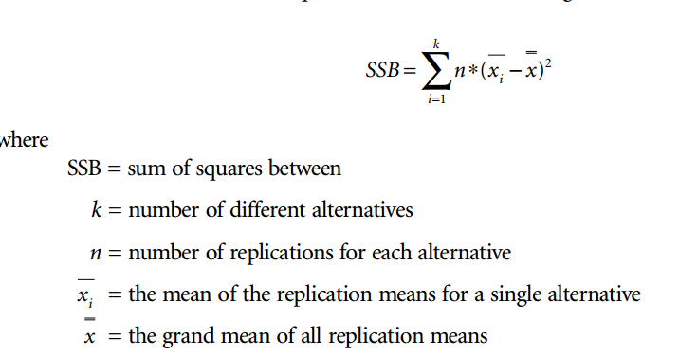
Calculating the Sum of Squares Between
The sum of squares between is calculated by summing the difference between the individual replication means and the alternative mean squared. SSB is calculated using the following formula:

Slide 47
Calculating the Sum of Squares Within
Next, we must calculate the sum of squares within (SSW). We could individually calculate each of these terms by summing the squared differences of each individual replication mean and its alternative mean or we could use the following formula:
SST = SSB + SSW
By rearranging this formula we can obtain the sum of squares within with what we already know and save an enormous number of calculations:
SSW = SST −SSB

Slide 48
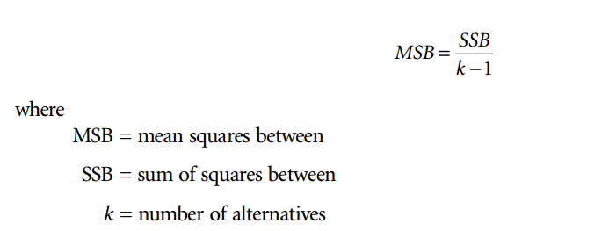
Calculating the Mean Squares Between
The mean squares between (MSB) is calculated by dividing the sum of squares between by the number of degrees of freedom associated with the alternatives. The number of degrees of freedom is the number of alternatives minus 1. The equation associated with this calculation is:

Slide 49
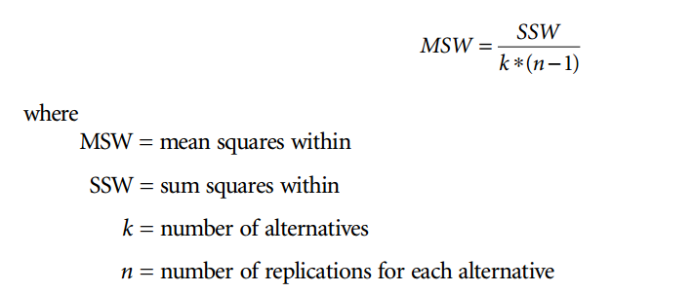
Calculating the Mean Squares Within
The mean squares within is calculated by dividing the sum of squares within by the number of degrees of freedom associated with the sum of squares within. The equation associated with this calculation is:

Slide 50
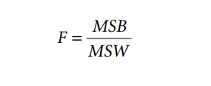
Calculating the F Statistic
The next step in the analysis of variance process is to calculate theF statistic. This is the ratio of the
mean squares between over the mean squares within.

Slide 51
Compare the F Statistic to the Critical Value
The final step is to compare the Fstatistic to the critical Fvalue.
The critical F value is obtained through an Fdistribution table.
The parameters needed to determine the Fvalue are the αlevel, the number of degrees of freedom on the numerator, and the number of degrees of freedom on the denominator.
The number of degrees of freedom for the numerator is the number of alternatives minus 1.
Similarly, the number of degrees of freedom for the denominator is the number of alternatives multiplied by the number of replications in the alternative minus 1. These equations are:

Slide 52
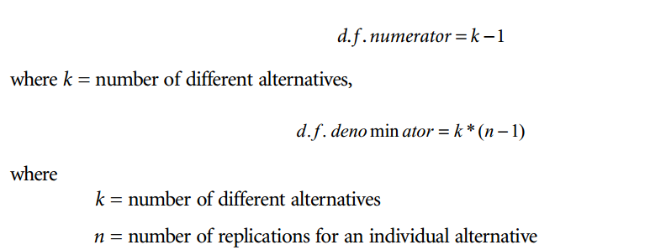
Compare the F Statistic to the Critical Value

Slide 53
Compare the F Statistic to the Critical Value
The calculated Ftest statistic is finally compared to the critical Fvalue obtained from the Fdistribution table.
If the test statistic is greater than the critical value then at least one of the alternatives is statistically different than the others.
Conversely, if the test statistic is less than the critical value, then all of the alternatives are statistically similar.

Slide 54
Duncan Multiple-Range Test
analysis of variance indicates that one or more means are statistically significantly different than the others, the practitioner will want to conduct a Duncan multiple-range test.
This test will indicate which means are statistically different from the others at a particular level of confidence.
The idea behind the Duncan test is that any set of adjacent means with a maximum–minimum range less than the calculated least significant range critical value is not statistically significant.
In other words if the spread between the maximum and minimum values in any adjacent set is less than the critical value, then all of the means in the adjacent set can be considered statistically similar.

Slide 55
Duncan Multiple-Range Test
if a larger set of adjacent means has been proven to be statistically similar, then all of the smaller sets of adjacent means within the larger set are also statistically similar.
This means, for example, if a set of four adjacent means is found to be statistically similar then any two- or three-set combinations of adjacent means are also statistically similar.

Slide 56
Duncan Test Procedure
Sort the replication means for each alternative in ascending order left to right.
Calculate the least significant range value for all of the possible sets of adjacent means.
Compare each set of possible adjacent means with the corresponding least significant range value in descending order with respect to the set size.
Mark the nonsignificant ranges.

Slide 57
Nonterminating System Analysis
The analysis of nonterminating systems differs significantly from that of terminating systems. This difference is a result of the following issues:
• Starting conditions
• Determining steady state
• Autocorrelation
• Length of replication
• The batch method

Slide 58
Starting Conditions
Nonterminating systems normally start only once and then continue on for an indefinite period of time.
The system may actually never close, or it may close and reopen in the same state that it closed.
Either way, it is considered as running for an indefinite period of time.
The practitioner can choose either of two different approaches:
1. Begin with the system empty.
2. Begin with the system loaded

Slide 59
Determining Steady State
The statistical comparison between nonterminating systems must be conducted only with data from the models in steady state.
So, before the practitioner can conduct any statistical comparison, the initial transient state, if one exists, must be removed.
There are a number of ways to approximate when the output measure of performance exits the initial transient state and enters the steady state. These include:
• Graphic approach
• Linear regression

Slide 60
Graphic Approach
In the graphic approach, the practitioner attempts to determine visually when the slope of the initial transient state approaches 0.
At this point, the output measure of performance has reached steady state.
Obviously, this qualitative approach is highly subjective and susceptible to influence by individual interpretation.

Slide 61
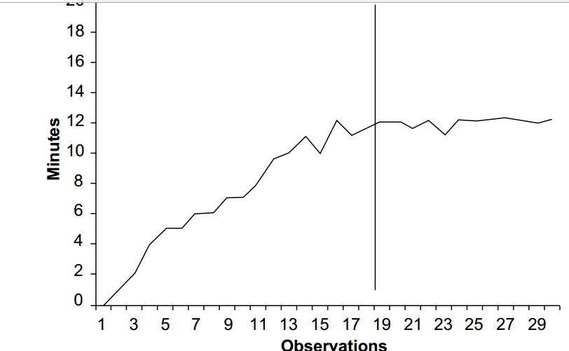
Graphic Approach

Slide 62
Linear Regression Approach
This involves testing a range of observations to see if the linear regression slope coefficient is equal to zero.
If the slope for a given range of observations is not zero, then the practitioner advances the range to a later set of observations. In this manner, the practitioner will eventually have a range of data for which the coefficient of the slope is insignificant.
At this point, the practitioner has reached the steady-state behavior of the system.

Slide 63
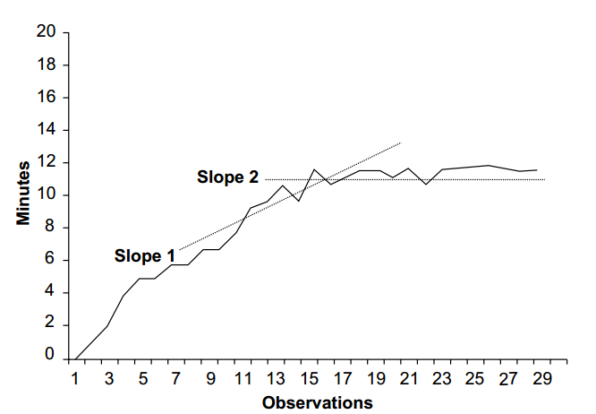
Linear Regression Approach

Slide 64
Autocorrelation
An issue that the practitioner must address with nonterminating systems is autocorrelation.
This is the tendency of subsequent observations of output measures of performance to be related to each other.
This occurs when, for example, the system time of one entity is correlated with the following entity.
If the first entity experienced a high system time, the next entity may also experience a high system time.
Similarly, if the first entity has a low system time, the next entity will also have a low system time. When this occurs, the system may be suffering from autocorrelation.

Slide 65
Autocorrelation
The danger of autocorrelation is that the practitioner may actually underestimate the actual variance in output measures of performance, such as system time.
If the practitioner underestimates the actual variance, the subsequent statistical comparisons may be affected.
Thus, if the system has autocorrelation and the practitioner does not account for it, the practitioner may inadvertently and accidentally reject a null hypothesis of no difference between systems.
There are a number of statistical methods available to attempt to account for autocorrelation such as Batch Method.

Slide 66
Batch Method
Instead of running several replications of relatively short durations we run the nonterminating system model for a single replication over a much longer time period and cut the run into separate batches.
The batches are then considered as individual replications.
The same comparison techniques can then be used for different alternatives. The steps in implementing this method are:
• Identify the nonsignificant correlation lag size.
• Make a batch ten times the size of the lag.
• Make the steady-state replication run length ten batches long.

Slide 67
Identify the Nonsignificant Correlation Lag Size
The purpose of this step is to identify the interval between observations that have little correlation to each other.
If there is little correlation, then autocorrelation becomes a nonissue. This interval is known as the lag.
If there is, for example, a lag of 100 observations, it means that the first and 101st, second and 102nd, etc. pairings of observations have no correlation.

Slide 68
Identify the Nonsignificant Correlation Lag Size
In this example, a nonterminating simulation was run for approximately 65,000 min.
This resulted in a total of 26,849 system time observations. Figure illustrates the use of the correlogram to identify the nonsignificant lag with these data.
As the correlogram indicates, the nonsignificant lag occurs at an interval of approximately 600 observations.

Slide 69
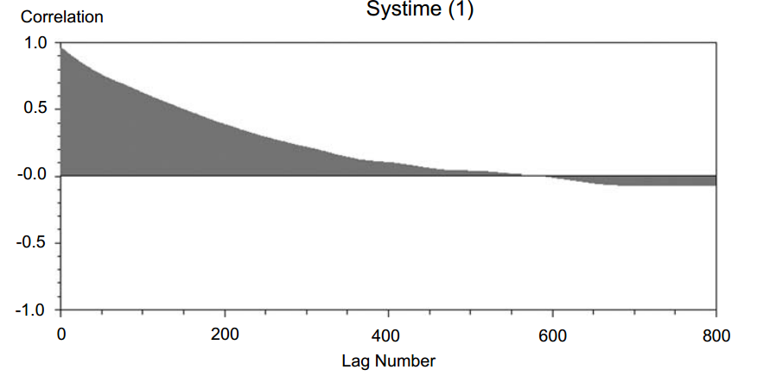
Identify the Nonsignificant Correlation Lag Size

Slide 70



Make a Batch Ten Times the Size of the Lag
Once the nonsignificant lag size has been determined, the practitioner can use the simulation rule of thumb of making a single batch ten times the lag size
The batch size usually has to be converted into time units for the simulation program. This can be accomplished by finding out how long it takes each system time observation to occur on the average:
This means that the time to obtain the number of observations for a batch size is:

Slide 71
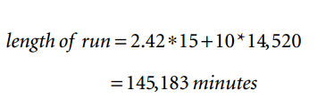
Make the Steady-State Replication Run Length Ten Batches Long
The next task is to determine how long to run the nonterminating simulation.
The length of the simulation must be long enough to remove the transient phase and have at least 10 batches of the required batch size.
In our example, our transient phase consisted of 15 observations. So, we will need to run our simulation for a total of at least: ( here 2.42 is single observation time as calculated above and 14520 is batch time as calculated above)

Slide 72
Make the Steady-State Replication Run Length Ten Batches Long
This simulation run will produce at least 6015 observations of individual entity system time.
We immediately discard the first 15 from the initial transient. The remaining 6000 or so will need to be divided into sequential batches of size 600.
This will result in 10 batches. These batches are now considered as individual replications. We can now perform the same sequence of statistical tests as with terminating systems. This includes testing ten batches for replication analysis.
In the event that ten replications arenot enough, the practitioner will have to increase the length of the run. When a sufficient number of replications has been achieved, the comparison of means is done with confidence intervals or ANOVA

Slide 73
Summary
Any Questions?

